Slide 1

Data Analysis on
Pizza Sales
by Yuva Teja

Slide 2
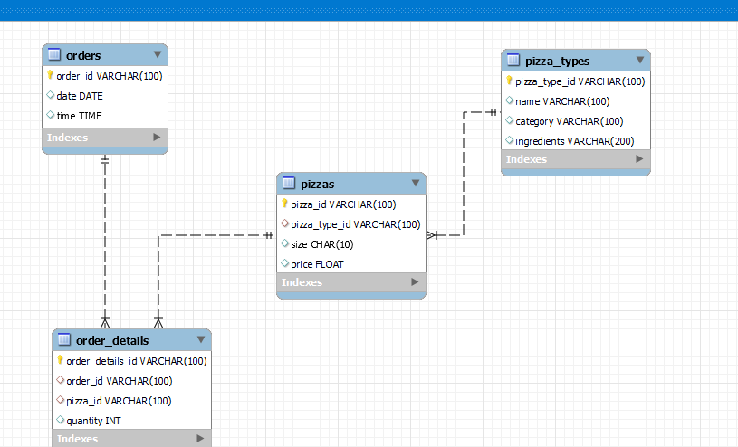

Slide 3
SQL Questions
Basic:
Retrieve the total number of orders placed.
Calculate the total revenue generated from pizza sales.
Identify the highest-priced pizza.
Identify the most common pizza size ordered.
List the top 5 most ordered pizza types along with their quantities.
Intermediate:
Join the necessary tables to find the total quantity of each pizza category ordered.
Determine the distribution of orders by hour of the day.

Slide 4
Join relevant tables to find the category-wise distribution of pizzas.
Determine the top 3 most ordered pizza types based on revenue.
Advanced:
Calculate the percentage contribution of each pizza type to total revenue.
Analyze the cumulative revenue generated over time.

Slide 5

1.Retrieve the total number of orders placed ??
SELECT COUNT(order_id) as Totalorders FROM orders ;

Slide 6

2. Calculate the total revenue generated from pizza sales ??
Select SUM(price*quantity)as TotalRevenue FROM order_details as od
JOIN pizzas as p ON od.pizza_id=p.pizza_id;

Slide 7
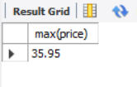
3. Identify the highest priced pizza ?
select MAX(price) FROM pizzas;

Slide 8
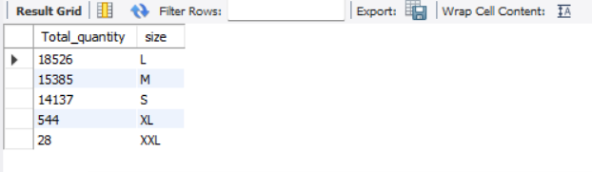
SELECT COUNT(quantity) as Total_quantity,size FROM pizzas as p JOIN order_details as od ON od.pizza_id=p.pizza_id GROUP BY size ORDER BY size;
4. Identify the common size ordered pizza ?

Slide 9
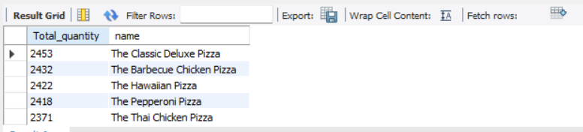
5. List the top 5 ordered pizza types along with quantity ?
SELECT SUM(quantity)as Total_quantity,name from order_details as od
JOIN pizzas as p ON p.pizza_id=od.pizza_id
JOIN pro.pizza_types as pt ON pt.pizza_type_id=p.pizza_type_id
GROUP BY name
ORDER BY Total_quantity desc
LIMIT 5;

Slide 10

SELECT SUM(quantity) as TotalQuantity,category from order_details as od JOIN pizzas as p ON p.pizza_id=od.pizza_id JOIN pizza_types as pt ON pt.pizza_type_id=p.pizza_type_id GROUP BY category ;
6.Total quantity of each pizza ordered ?

Slide 11
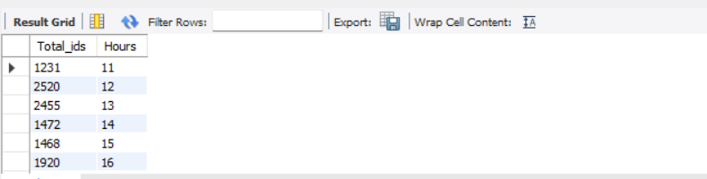
select count(order_id) as Total_id,hour(time) as Hours from orders group by Hours;
7.Distribution of orders by an hour of the day ?

Slide 12
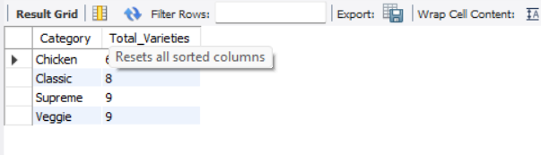
8.Find the category wise distribution of pizzas ?
SELECT Category,count(name) as Total_Varieties FROM pizza_types GROUP BY Category;

Slide 13
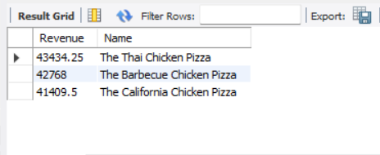
9.Determine top 3 ordered pizzas type based on revenue ??
SELECT SUM(price*quantity) as Revenue,name as Name FROM order_details as od JOIN pizzas as p ON p.pizza_id=od.pizza_id
JOIN pizza_types as pt ON pt.pizza_type_id=p.pizza_type_id
GROUP BY name
ORDER BY revenue DESC LIMIT 3;

Slide 14
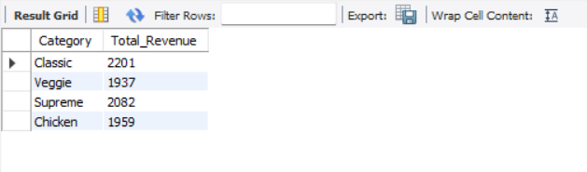
10.Calculating % contribution of each pizza to total revenue ??
SELECT category as Category,ROUND(SUM(price*quantity)/100) as Total_Revenue FROM order_details as od JOIN pizzas as p ON p.pizza_id=od.pizza_id
JOIN pizza_types as pt ON pt.pizza_type_id=p.pizza_type_id
GROUP BY category;

Slide 15
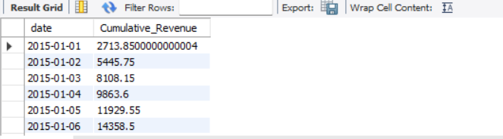
11.Analyse cumulative revenue ??
SELECT date ,SUM(revenue) over(ORDER BY date) as Cumulative_Revenue FROM(SELECT SUM(price*quantity) as revenue,date FROM order_details as od JOIN pizzas as p ON p.pizza_id=od.pizza_id JOIN pizza_types as pt ON pt.pizza_type_id=p.pizza_type_id JOIN orders as o ON od.order_id=o.order_id GROUP BY date) as sales ;

